Slide 1

What is DevOps ?

Slide 2
The Core Principles of DevOps
Collaboration: Promotes open communication and teamwork between development and operations, fostering shared responsibility.
Automation: Reduces manual work, minimizes errors, and accelerates processes, leading to consistent and faster delivery.
CI/CD (Continuous Integration and Continuous Delivery): Automates the building, testing, and deployment of software to ensure a steady flow of high-quality releases.
Feedback and Monitoring: Focuses on collecting feedback and monitoring systems to improve processes and products continuously.
Continuous Learning and Improvement: Encourages teams to regularly assess and enhance their tools and processes for ongoing growth and optimization.

Slide 3
Benefits of Implementing DevOps in Your Organization
A Faster Delivery and Time-to-Market: DevOps speeds up software releases, helping your organization quickly adapt to market changes and customer needs.
Improved Quality and Reliability: Automation and continuous testing in DevOps ensure software is high-quality, reliable, and secure.
Enhanced Collaboration and Communication: DevOps encourages open communication and teamwork, breaking down silos and aligning teams for more efficient processes.
Cost Savings: Streamlining workflows and reducing manual work with DevOps can save your organization money.
Increased Customer Satisfaction: Faster delivery and better-quality products help meet customer expectations, boosting satisfaction and loyalty.

Slide 4
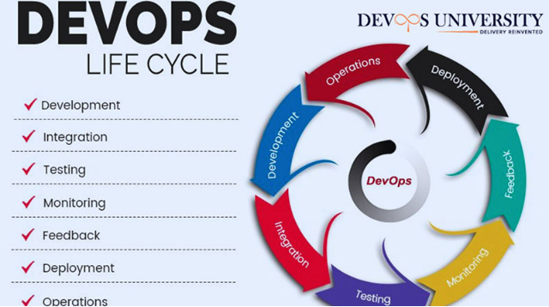

Slide 5
DevOps Lifecycle Components:
Continuous Development: This phase focuses on planning and coding. Developers plan the software based on project goals and select appropriate programming languages like JavaScript, C/C++, or Python.
Continuous Integration: After development, code changes are automatically integrated and tested to ensure they work together. Tools like Jenkins automate this process, building new versions seamlessly.
Continuous Testing: Applications are tested continuously to catch bugs early. Automated testing tools, often using Docker containers, ensure the application is reliable and ready for production.
Continuous Monitoring: The software is monitored in real-time to track its performance and identify issues. This phase helps ensure the application remains secure and available, addressing problems like server outages or low memory.
Continuous Feedback: Feedback is gathered from users and testing to identify areas for improvement. This stage is crucial for refining the application based on real-world usage and user experience.
Continuous Deployment: New code is deployed without disrupting the live environment, even on high-traffic sites. Tools like Chef, Puppet, Ansible, and Docker ensure consistent and smooth deployments across different environments.
Continuous Operations: This phase automates the release and update processes, allowing for quick and efficient rollouts. It ensures a continuous cycle of development and deployment, reducing time-to-market.

Slide 6
Difference between CD & CD
Feature | Continuous Development | Continuous Delivery
Scope | Entire software delivery lifecycle | Deployment stage
Automation | Automates all stages | Automates deployment
Goal | Reduce time to market and improve quality | Ensure code is always releasable
Manual Approval | May involve manual approval for critical changes | Often requires manual approval for production deployments

Slide 7
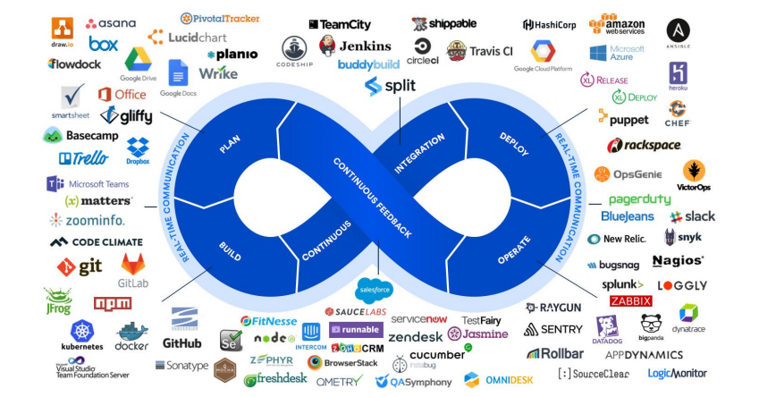
The Big Picture

Slide 8
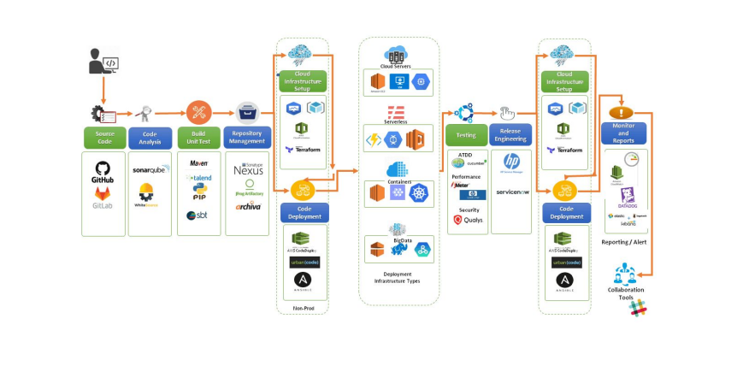
The DevOps Flow

Slide 9
Why DevSecOps ?
1. Integrates Security Early in the Development Lifecycle
Shifts security "left" to identify and fix vulnerabilities earlier, reducing costs and risks.
2. Enhances Collaboration Across Teams
Encourages developers, security, and operations teams to work together, fostering a culture of shared responsibility for security.
3. Automates Security Processes
Uses automated tools to continuously scan code for vulnerabilities, ensuring secure software without slowing down development.
4. Responds Faster to Threats
Improves the ability to respond to security incidents and threats in real-time, reducing potential damage.
5. Ensures Compliance and Governance
Helps maintain compliance with regulatory requirements through automated checks and documentation.

Slide 10
Key DevSecOps Tools:
Static Application Security Testing (SAST): SonarQube, Fortify
Dynamic Application Security Testing (DAST): OWASP ZAP, Burp Suite
Software Composition Analysis (SCA): Black Duck, Snyk
Container Security: Aqua Security, Twistlock
Infrastructure as Code (IaC) Security: Checkov, Terraform Sentinel
Security Monitoring and Incident Response: Splunk, ELK Stack,ServiceNow – Telealerts ,Pagerduty ➔
Different svc model / N/w topics devops – Linux

